Slide 1

A Presentation on CLUB MANAGEMENT SYSTEM
Presented By
Khandaker Tasfia Reza (19202103286)
Tanbir Hasan Bhuiyan (19202103294)
Md Mahabub Morshed (19202103298)
Munzirul Alom (19202103303)
D.M Ajmain Shaharir (19202103308)
Supervised by
Ms Sadah Anjum Shanto
Lecturer of
Dept. of CSE (BUBT)

Slide 2
Outline of This Presentation
Introduction
Objectives
Motivation
Features
Audience
UML Diagrams
Implementation
Limitations
Future Works
Conclusion

Slide 3
2
Introduction

Slide 4
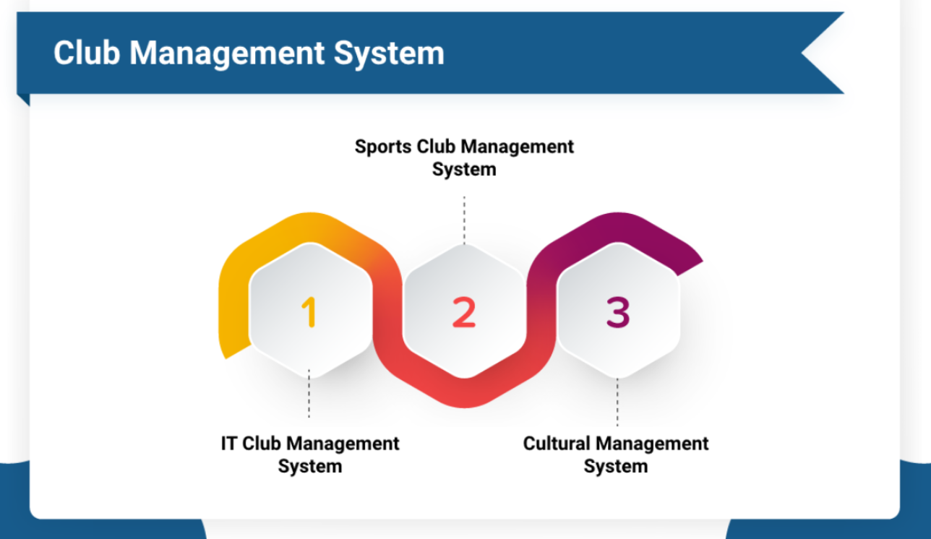
Introduction
Club Management System (CMS) ?
Is CMS important?
(Who are the) Users of CMS?
(What are the) Benefits of using this CMS?

Slide 5
The problems with the manual club management system
1. Manual Data record-keeping
2. Users can’t see the events visually
3. Security
4.

Slide 6
2
Objectives

Slide 7

Objectives
Well developed system
Framework less raw coded application
Interactive dashboard
Efficient web application
Passing control
work and events easy management
Open source project

Slide 8
3
Motivation

Slide 9
Motivation
Reasons behind choosing this system
Lack of available management system
No well-organized club
No free club management services
Processor: - Intel Pentium 3 or above

Slide 10
4
Features

Slide 11
System Features
Multiple Admin
User Own Profile
Event creation
Notifications
Club-wise Accessibility
Password Recovery
Member Chatting
Club Creations
Level Wise Accessibility

Slide 12
5
Audiences

Slide 13
Audiences
Separate admin for every club
Single president and vice-president
Executive member controls event
General members are volunteer

Slide 14
6
UML Diagrams

Slide 15
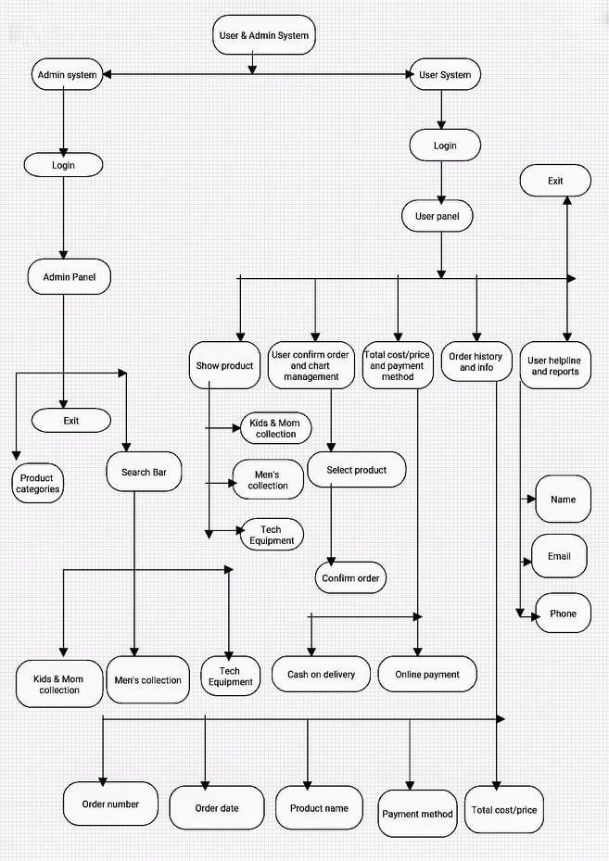
INFRASTRUCTURE OF OUR MANAGEMENT SYSTEM

Slide 16
7
Implementations

Slide 17
System Requirements
HARDWARE ( Minimum Requirements )
Minimum RAM: - 2GB or more
Hard Disk: - 32 GB or more
Processor: - Intel Pentium 3 or above
SOFTWARE ( Minimum Requirements )
Operating system: Windows XP,7 or any latest OS.
Wamp server
MySQL, PHP
GitHub and Latex (ONLINE tools).
Analyzing Software: Sublime Text

Slide 18
8
limitations

Slide 19

Limitations
Unusual but little limitations
No paid event participation
Notifications
Notifications via Email
Chatting with other members

Slide 20
9
Future Works

Slide 21
Related work and their infrastructure
Email and Web notification System
Payment gateway integration
Club-wise task management system
Communication System

Slide 22
10
conclusion

Slide 23
10
Conclusion

Slide 24
6
Design and interface

Slide 25
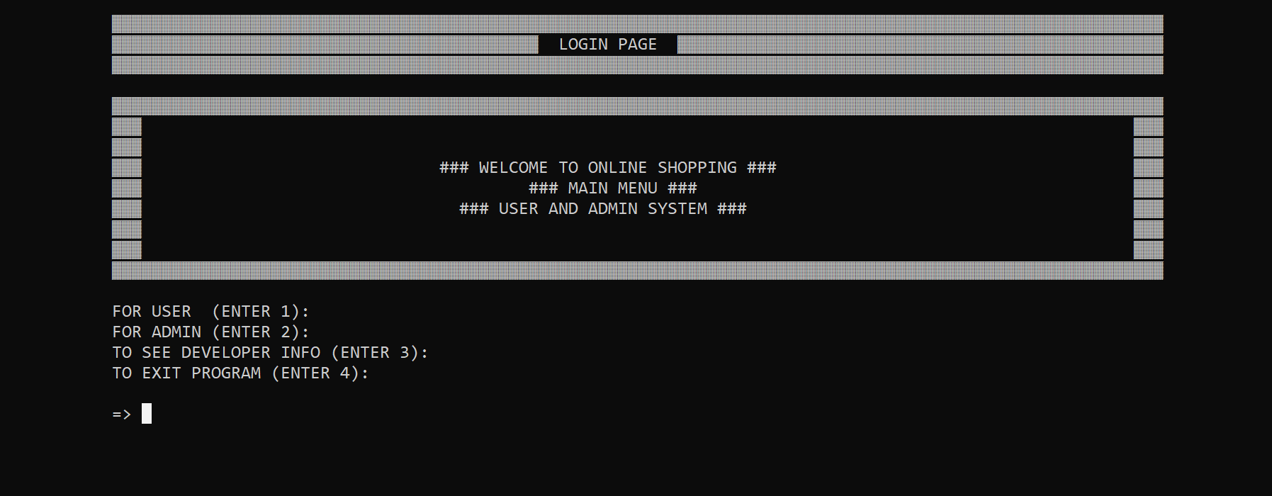
Login Page

Slide 26
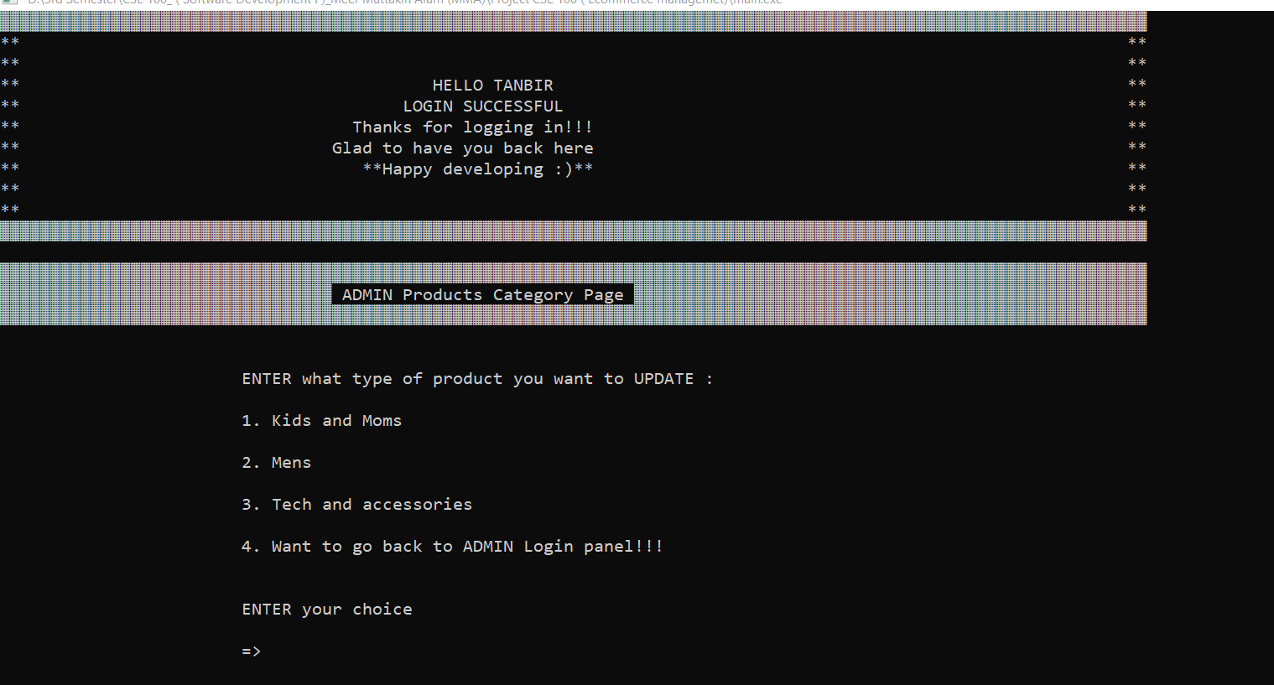
Admin Login Successful & Developer Category Section

Slide 27
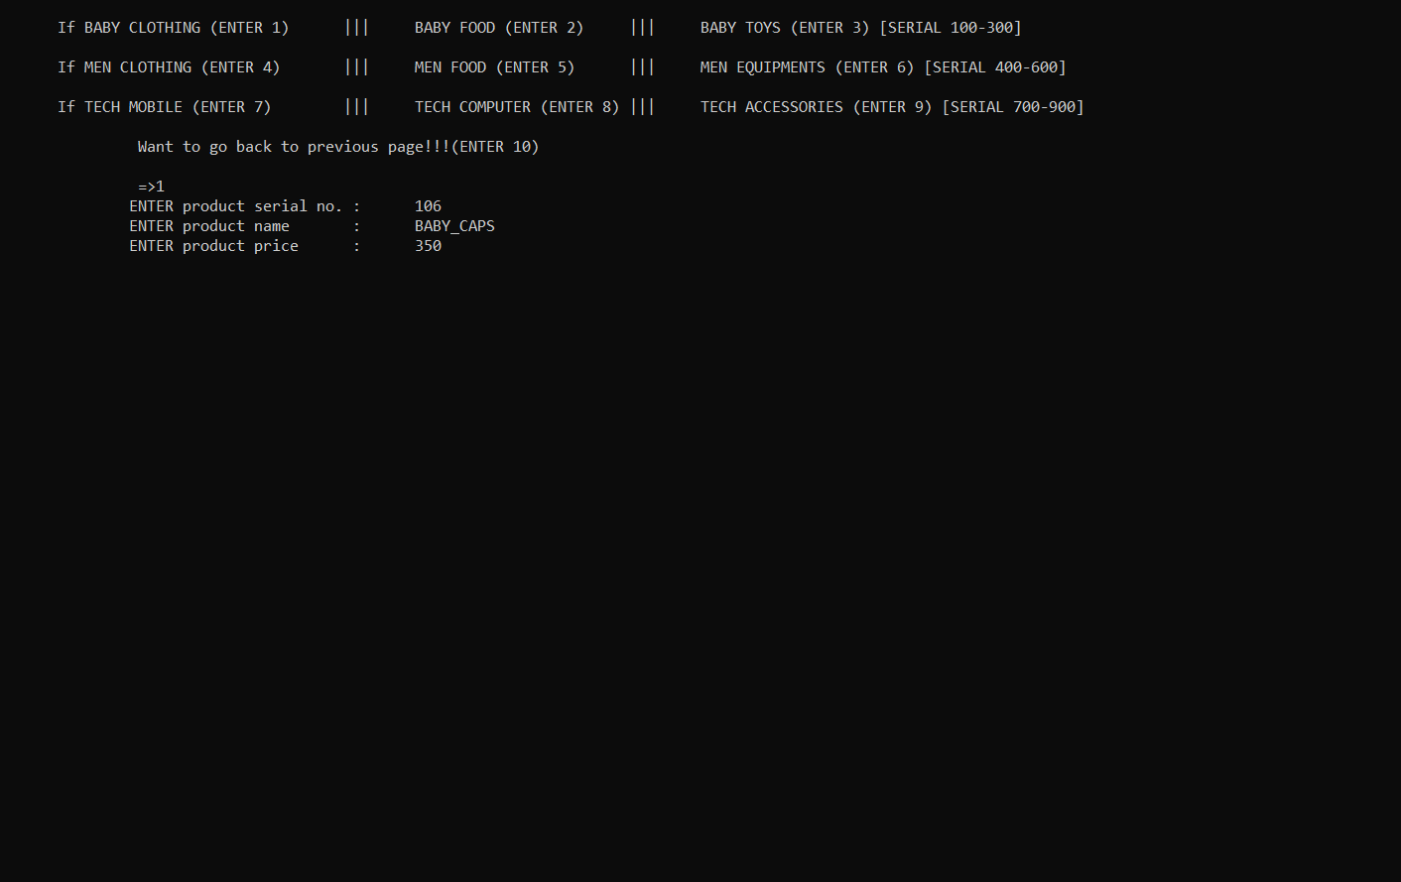
Add & Delete Products by Admin from Any Category

Slide 28
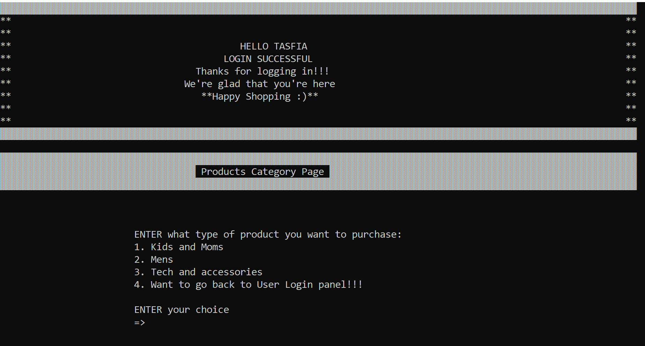
Successful User Login & Product Categories

Slide 29
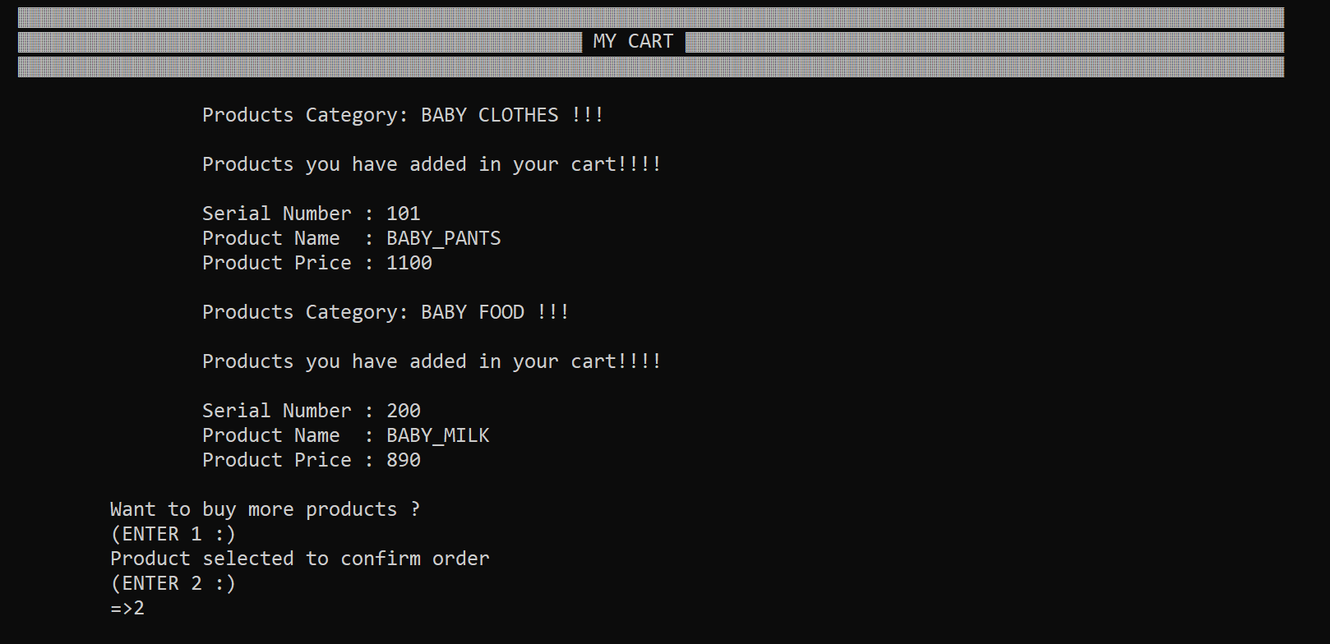
Baby Food and Clothes Selected to Order in the Cart

Slide 30
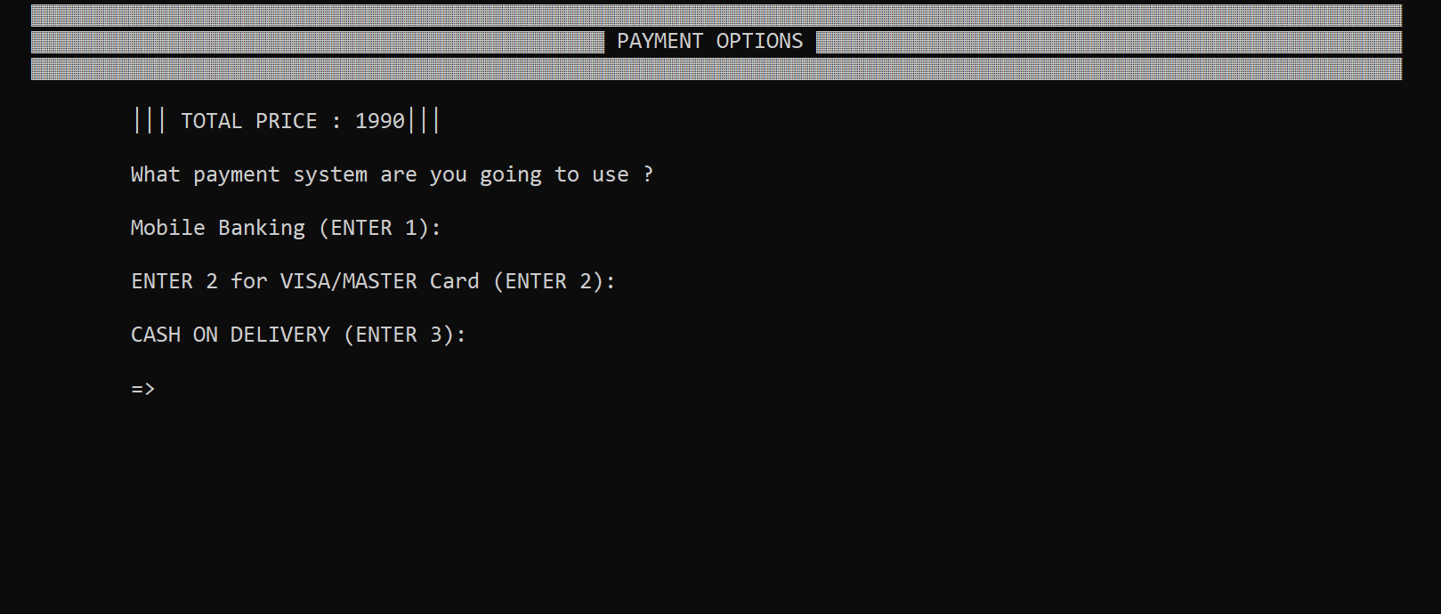
Payment Section to Select Payment Methods

Slide 31
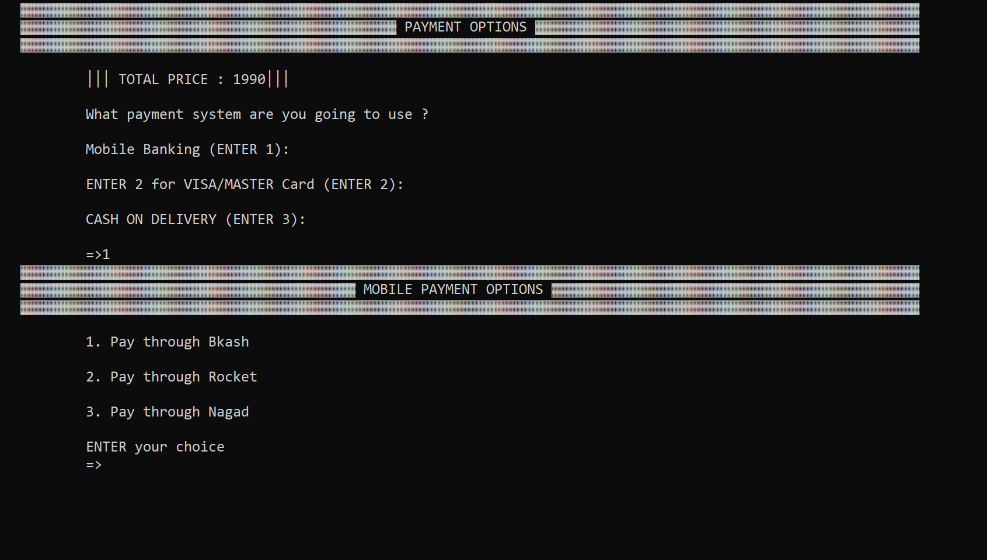
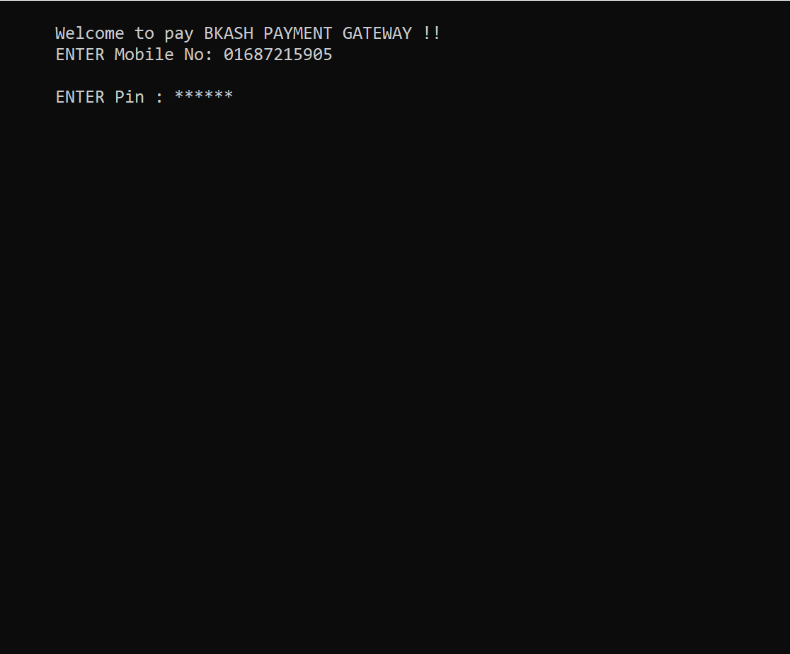
Mobile Payment Option and Payment Gateway

Slide 32
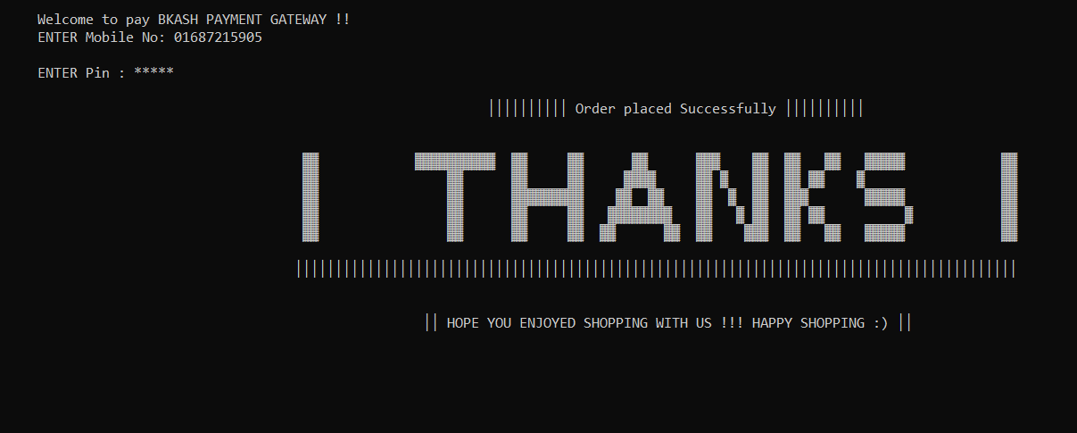
Order Placement Successful

Slide 33
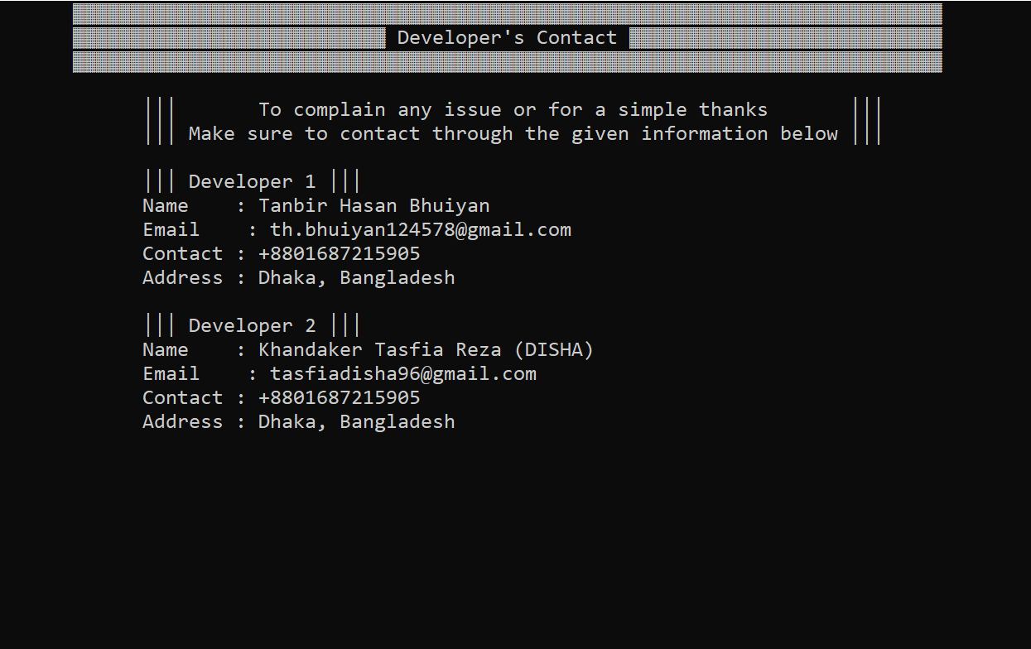
Developer Contacts

Slide 34
7
Conclusion & Future works

Slide 35
Conclusion
Designing an actual e-commerce site is definitely more expensive and entailed more than I had planned on doing initially. Yet I have managed to do couple of features such as,
User/Admin Login and Registration
User/Admin Product Category
Product/Order/Modify/Update
Cart
Payment
Developer info/Reports

Slide 36
Future works
Efficient useful payment system
Increase product categories
Improve products data and visuality
Improve design and functionality

Slide 37
References
E-commerce – GeeksforGeeks
E-commerce - Wikipedia
saurab Mondal. “how does ecommerce work?”.https://www.linkedin.com/pulse/how-does-ecommerce-work-saurabh-manda/, 2015
Bartleby. “e-commerce in china”.https://www.ipl.org/essay/China-Travel-Case-Study-FCDJ2PZAK5U, 2018
Laduram vishnoi.“the problem with the e-commerce system ”.https://acquire.io/blog/problems-solutions-ecommerce-faces/, November 9, 2016
sahi hui, Lian hua wang, wei qi.“analyzing the development of e-commerce”.https://www.researchgate.net/publication/316068939AnalyzingCollaborative,2017.

Slide 38
Thank you all
for your patience.

Slide 39
Any Questions
?

